Slide 1
Dynamic Programming
LCS

Slide 2
Dynamic Programming (DP)
Dynamic Programming is a strategy for designing algorithm.
» A meta-technique, not an algorithm (like divide & conquer)
» “Programming” in this context refers to a tabular method
» not to writing computer code.

Slide 3
Basic Principle
Used when problem breaks down into recurring small subproblems
Used when the solution can be recursively described in terms of solutions to subproblems (optimal substructure).
Algorithm finds solutions to subproblems and stores them in memory for later use.

Slide 4
Dynamic Programming vs Divide and Conquer
Dynamic programming
Dynamic programming solves problems by combining the solutions to sub-problems.
Dynamic Programming vs Divide and Conquer
Are they same?

Slide 5
Dynamic Programming vs Divide and Conquer
No!
Divide-and-conquer algorithms partition the problem into disjoint subproblems, solve the subproblems recursively, and then combine their solutions to solve the original problem.
In contrast, dynamic programming applies when the subproblems overlap, that is, when subproblems share sub-subproblems.

Slide 6
Dynamic Programming vs Divide and Conquer
Overlapping Subproblems
In this context, a divide-and-conquer algorithm does more work than necessary, repeatedly solving the common sub-subproblems.
A dynamic-programming algorithm solves each sub-subproblem just once and then saves its answer in a table.
Avoids the work of re-computing the answer every time it solves each sub-subproblem.

Slide 7
Dynamic Programming: When Apply?
We typically apply dynamic programming to optimization problems.
Such problems can have many possible solutions.
Each solution has a value, and we wish to find a solution with the optimal (minimum or maximum) value.
We call such a solution an optimal solution to the problem, as opposed to the optimal solution, since there may be several solutions that achieve the optimal value.

Slide 8
Using Dynamic Programming for Optimal Solution
There are two approach to develop a dynamic programming solution:
Top-Down (Memoization): In this recursive approach, we write the procedure recursively in a natural manner, but modified to save the result of each subproblem (usually in an array). The procedure now first checks to see whether it has previously solved this subproblem. If so, it returns the saved value, saving further computation at this level; if not, the procedure computes the value in the usual manner. Here we start from the main problem and then break it down.
Bottom-Up (Tabulation): In this iterative approach, we start from the base case and build up the solution. When solving a particular subproblem, we have already solved all of the smaller subproblems its solution depends upon, and we have saved their solutions. We solve each subproblem only once, and when we first see it, we have already solved all of its prerequisite subproblems.

Slide 9
Dynamic Programing
Every DP problem can be solved in two ways
Iteratively
Recursively
Notes:
Which one is better and faster

Slide 10
Longest Common Subsequence
LCS Problem Statement: Given two sequences, find the length of longest subsequence present in both of them.
A subsequence is a sequence that appears in the same relative order, but not necessarily contiguous.

Slide 11
Longest Common Subsequence
What are the Subsequences of “ABC”
Total way = 2˄n
Common Subsequence between two string and LCS
Examples: LCS for input Sequences “ABCDGH” and “AEDFHR” is “ADH” of length 3. LCS for input Sequences “AGGTAB” and “GXTXAYB” is “GTAB” of length 4.
Brut force approach (if n > 25)

Slide 12

LCS : “HELLOM” and “HMLLD”
Start with first element
If they are same: include them into LCS

Slide 13

LCS : “HELLOM” and “HMLLD”
Recursively solve the rest string
We have sorter strings “ELLOM” and “MLLD”. Solve it recursively.
Here E and M are not same. So, we have to drop one.

Slide 14
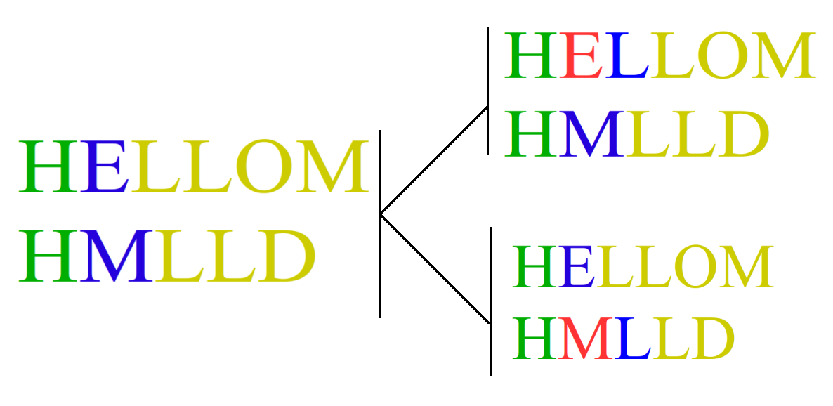
LCS : “HELLOM” and “HMLLD”
Once we have to drop E and next we drop M.
LCS(“ELLOM”, “MLLD”) ->Max[ LCS(“LLOM”, “MLLD”) and LCS(“ELLOM”, “LLD”)]

Slide 15
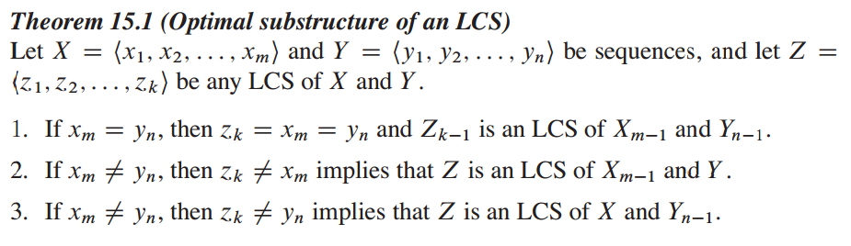
Longest Common Subsequence

Slide 16
Longest Common Subsequence: Base Case
Let, x[m] represented by x[i] where i is 1 to m.
Let, y[n] represented by y[j] where j is 1 to n.
C[i, j] represents LCS.
If i or j is 0, then, one of the sequences has length 0, and so the LCS has length 0.

Slide 17
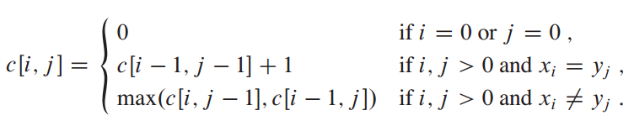
Longest Common Subsequence: Base Case
Let, x[m] represented by x[i] where i is 1 to m.
Let, y[n] represented by y[j] where j is 1 to n.
C[i, j] represents LCS.

Slide 18
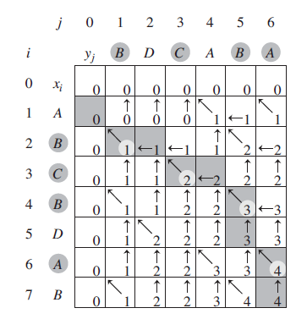
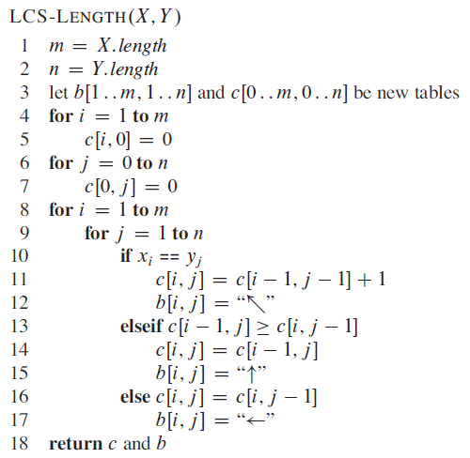
Longest Common Subsequence

Slide 19
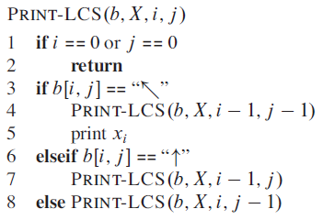
Longest Common Subsequence

Slide 20
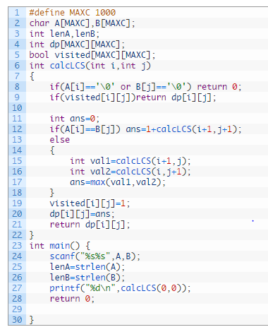
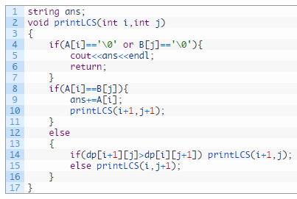
Longest Common Subsequence : Recursviely

Slide 21
Longest Common Subsequence :
int main()
{ int m=0;
int n=0;
cout<<"The length of 1st sequence:";
cin>>m;
cout<<"The first sequence:";
char s1[m];
for(int i=0;i<m;i++)
{
cin>>s1[i];
}
cout<<"The length of 2nd sequence:";
cin>>n;
cout<<"The second sequence:";
char s2[n];
for(int j=0;j<n;j++)
{
cin>>s2[j];
}
lcsAlgo(s1,s2,m,n);
}
#include<bits/stdc++.h>
using namespace std;
void lcsAlgo(char *s1,char *s2,int m,int n)
{
int lcsTable[m+1][n+1];
for(int i=0;i<=m;i++)
{for(int j=0;j<=n;j++)
{if(i==0 || j==0)
{
lcsTable[i][j]=0;
}
else if(s1[i-1]==s2[j-1])
{
lcsTable[i][j]=lcsTable[i-1][j-1]+1;
}
else
{
lcsTable[i][j]=max(lcsTable[i-1][j],lcsTable[i][j-1]);
} } }
int lcs_length=lcsTable[m][n];

Slide 22
Longest Common Subsequence :
char lcs[lcs_length];
lcs[lcs_length]='\0';
int i=m,j=n;
while(i>0 && j>0)
{ if(s1[i-1]==s2[j-1])
{
lcs[lcs_length-1]=s1[i-1];
i--;
j--;
lcs_length--;
}
else if(lcsTable[i-1][j]>lcsTable[i][j-1])
i--;
else
j--; }
lcs_length=lcsTable[m][n];
cout<<"The first sequence:";
cout<<s1<<endl;
cout<<"The second sequence:";
cout<<s2<<endl;
cout<<"The LCS:"<<lcs<<endl;
cout<<"LCS length:"<<lcs_length;}
#include<bits/stdc++.h>
using namespace std;
void lcsAlgo(char *s1,char *s2,int m,int n)
{
int lcsTable[m+1][n+1];
for(int i=0;i<=m;i++)
{for(int j=0;j<=n;j++)
{if(i==0 || j==0)
{
lcsTable[i][j]=0;
}
else if(s1[i-1]==s2[j-1])
{
lcsTable[i][j]=lcsTable[i-1][j-1]+1;
}
else
{
lcsTable[i][j]=max(lcsTable[i-1][j],lcsTable[i][j-1]);
} } }
int lcs_length=lcsTable[m][n];

